Slide 1

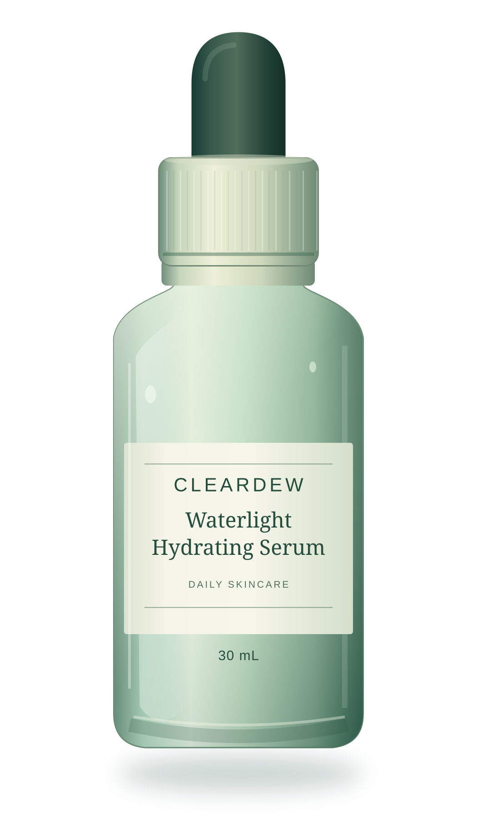
CLEARDEW
EVERYDAY SKINCARE
BEAUTY PRODUCT INTRODUCTION
Waterlight
Hydrating Serum
A fresh take on
everyday hydration.
30 mL
A simple daily serum, thoughtfully imagined.
ORIGINAL PACKAGING CONCEPT
FICTIONAL BEAUTY PRODUCT CONCEPT
01 / 08
Notes:
Introduce CLEARDEW Waterlight Hydrating Serum as a fictional product concept. The central idea is an uncomplicated hydration-focused serum with a water-light sensory direction and a considered dropper bottle. This deck demonstrates an English-language beauty product presentation, not a recommendation to purchase or use an existing product.
CLEARDEW is an original fictional beauty product. Packaging, sizes, sensory attributes, ingredient selections and visual identity are concept directions, not validated commercial specifications. All visual assets were created specifically for this presentation. No external product photos are used.

Slide 2

CLEARDEW
01 / THE IDEA
Less complexity.
More everyday care.
01
02
03
A lighter feel
An easier routine
A calmer ritual
For people who prefer a serum step without a rich, heavy texture.
A straightforward format to fit between cleansing and moisturizer.
A small, intentional moment in the morning or at the end of the day.
THE BRIEF
One focused serum step, not an elaborate routine.
FICTIONAL BEAUTY PRODUCT CONCEPT
02 / 08
Notes:
Describe the three preferences that inspired the product concept: lighter-feeling skincare, a simpler routine, and a calm everyday ritual. These are proposed customer motivations and design aims. No research sample, sales data or validated consumer preference is implied.
CLEARDEW is an original fictional beauty product. Packaging, sizes, sensory attributes, ingredient selections and visual identity are concept directions, not validated commercial specifications. All visual assets were created specifically for this presentation. No external product photos are used.

Slide 3
CLEARDEW
02 / PRODUCT OVERVIEW
Meet your shelf essential.
A considered format for a daily skincare routine.
FORMULA
PACKAGING
Water-based serum
Dropper format
A hydration-focused formula direction with a water-light feel.
A familiar dispensing design for an easy daily serum step.
SIZE
FORMULATION BRIEF
30 mL bottle
No added fragrance
A compact concept size for the everyday beauty shelf.
A fragrance-free direction proposed for the formula.
All specifications shown are proposed concept directions, not tested product claims.
FICTIONAL BEAUTY PRODUCT CONCEPT
03 / 08
Notes:
Walk through the proposed specifications: a water-based serum, a dropper format, a 30 mL bottle and a no-added-fragrance formulation direction. These specifications are invented for the concept and should be replaced with confirmed brand information before any commercial use. The packaging is an illustration, not a photo of a manufactured item.
CLEARDEW is an original fictional beauty product. Packaging, sizes, sensory attributes, ingredient selections and visual identity are concept directions, not validated commercial specifications. All visual assets were created specifically for this presentation. No external product photos are used.

Slide 4
CLEARDEW
03 / INGREDIENT STORY
Hydration starts
with the formula.
Three ingredient ideas.
One focused direction.
H₂O
01
HA
02
G
03
Water-based foundation
Hyaluronic acid
Glycerin
The base of the proposed water-light serum concept.
A moisturizing ingredient commonly used in skincare.
A humectant used in moisturizing skincare formulas.
Proposed ingredients only; the complete formula and product performance have not been established.
FICTIONAL BEAUTY PRODUCT CONCEPT
04 / 08
Notes:
Present the formula as a concept rather than a tested recipe. Water is the chosen base for this fictional product. The American Academy of Dermatology describes hyaluronic acid as a moisturizing ingredient, and the European Commission CosIng database lists glycerin as a humectant and skin-conditioning humectant. These ingredient-level roles do not establish the performance or safety of CLEARDEW, for which no finished formula exists.
CLEARDEW is an original fictional beauty product. Packaging, sizes, sensory attributes, ingredient selections and visual identity are concept directions, not validated commercial specifications. All visual assets were created specifically for this presentation. No external product photos are used.
[Sources]
- American Academy of Dermatology, How to pick the right moisturizer for your skin: https://www.aad.org/public/everyday-care/skin-care-basics/dry/pick-moisturizer
- European Commission, CosIng, GLYCERIN ingredient functions: https://ec.europa.eu/growth/tools-databases/cosing/details/34040
[/Sources]

Slide 5

CLEARDEW
04 / TEXTURE
A lighter
kind of ritual.
THE SENSORY DESIGN BRIEF
01
Dispense
A clear, fluid drop.
02
Smooth
A soft, easy-to-spread feel.
03
Layer
A finish designed to sit under moisturizer.
LIGHT BY DESIGN
Texture illustration only; not a product test.
FICTIONAL BEAUTY PRODUCT CONCEPT
05 / 08
Notes:
Use the texture illustration to communicate the desired sensory direction: fluid dispensing, easy spreading and a lightweight layering experience. These are design targets, not measured absorption, finish, makeup-compatibility or performance results. The swatch is an original illustration and must not be presented as a laboratory or before-and-after image.
CLEARDEW is an original fictional beauty product. Packaging, sizes, sensory attributes, ingredient selections and visual identity are concept directions, not validated commercial specifications. All visual assets were created specifically for this presentation. No external product photos are used.

Slide 6




CLEARDEW
05 / HOW TO USE
Four steps. One easy routine.
An illustrative place for the serum in a daily skincare routine.
→
→
→
01 / Cleanse
02 / Apply serum
03 / Moisturize
04 / Protect (AM)
Begin with a gentle cleanse.
Use the amount on the final product label.
Follow with your moisturizer.
Broad-spectrum SPF 30+ in the morning.
With any real product: follow its label and test it on a small area before regular use.
FICTIONAL BEAUTY PRODUCT CONCEPT
06 / 08
Notes:
Explain the general sequence rather than a finished CLEARDEW instruction label. The American Academy of Dermatology recommends cleansing first, then treatment products, then moisturizer and/or sunscreen, and makeup if desired. It recommends broad-spectrum SPF 30 or higher as part of daily sun protection. It also recommends testing a new skincare product on a small area before regular use; its home-testing guide describes twice-daily application for seven to ten days. No exact serum quantity, frequency or suitability can be specified for this untested concept; those would require a real formula and final label.
CLEARDEW is an original fictional beauty product. Packaging, sizes, sensory attributes, ingredient selections and visual identity are concept directions, not validated commercial specifications. All visual assets were created specifically for this presentation. No external product photos are used.
[Sources]
- American Academy of Dermatology, Should I apply my skin care products in a certain order?: https://www.aad.org/public/everyday-care/skin-care-basics/care/apply-skin-care-certain-order
- American Academy of Dermatology, How to pick the right moisturizer for your skin: https://www.aad.org/public/everyday-care/skin-care-basics/dry/pick-moisturizer
- American Academy of Dermatology, How to test skin care products: https://www.aad.org/public/everyday-care/skin-care-secrets/prevent-skin-problems/test-skin-care-products
[/Sources]

Slide 7



CLEARDEW
06 / EVERYDAY MOMENTS
Made for everyday moments.
01
02
03
The morning reset
Before makeup
The evening wind-down
A small skincare pause before a busy day.
A serum step before moisturizer, sunscreen and makeup.
A quiet moment in an end-of-day care routine.
FICTIONAL BEAUTY PRODUCT CONCEPT
07 / 08
Notes:
Use the three lifestyle illustrations to position the concept in ordinary moments rather than in claims about skin transformation. The morning and evening scenes are proposed usage occasions, not validated frequency instructions. The makeup scene follows the American Academy of Dermatology general order of skincare followed by makeup; no specific compatibility or makeup-wear benefit has been tested.
CLEARDEW is an original fictional beauty product. Packaging, sizes, sensory attributes, ingredient selections and visual identity are concept directions, not validated commercial specifications. All visual assets were created specifically for this presentation. No external product photos are used.
[Sources]
- American Academy of Dermatology, Should I apply my skin care products in a certain order?: https://www.aad.org/public/everyday-care/skin-care-basics/care/apply-skin-care-certain-order
[/Sources]

Slide 8

CLEARDEW
07 / THE TAKEAWAY
Keep it simple.
Keep it dewy.
CLEARDEW Waterlight Hydrating Serum
Water-based concept. Thoughtful ingredients.
An uncomplicated place in your routine.
YOUR EVERYDAY HYDRATION STEP
CLEARDEW is a fictional product created for this presentation.
No clinical results, certifications or commercial availability are implied.
FICTIONAL BEAUTY PRODUCT CONCEPT
08 / 08
Notes:
Close with the positioning line: Keep it simple. Keep it dewy. Recap the fictional product as a water-based, hydration-focused serum concept with a considered ingredient direction and a simple place in an everyday routine. Before adapting the presentation for a real brand, replace the concept name, visuals, specifications and claims with approved product information.
CLEARDEW is an original fictional beauty product. Packaging, sizes, sensory attributes, ingredient selections and visual identity are concept directions, not validated commercial specifications. All visual assets were created specifically for this presentation. No external product photos are used.

